Slide 1

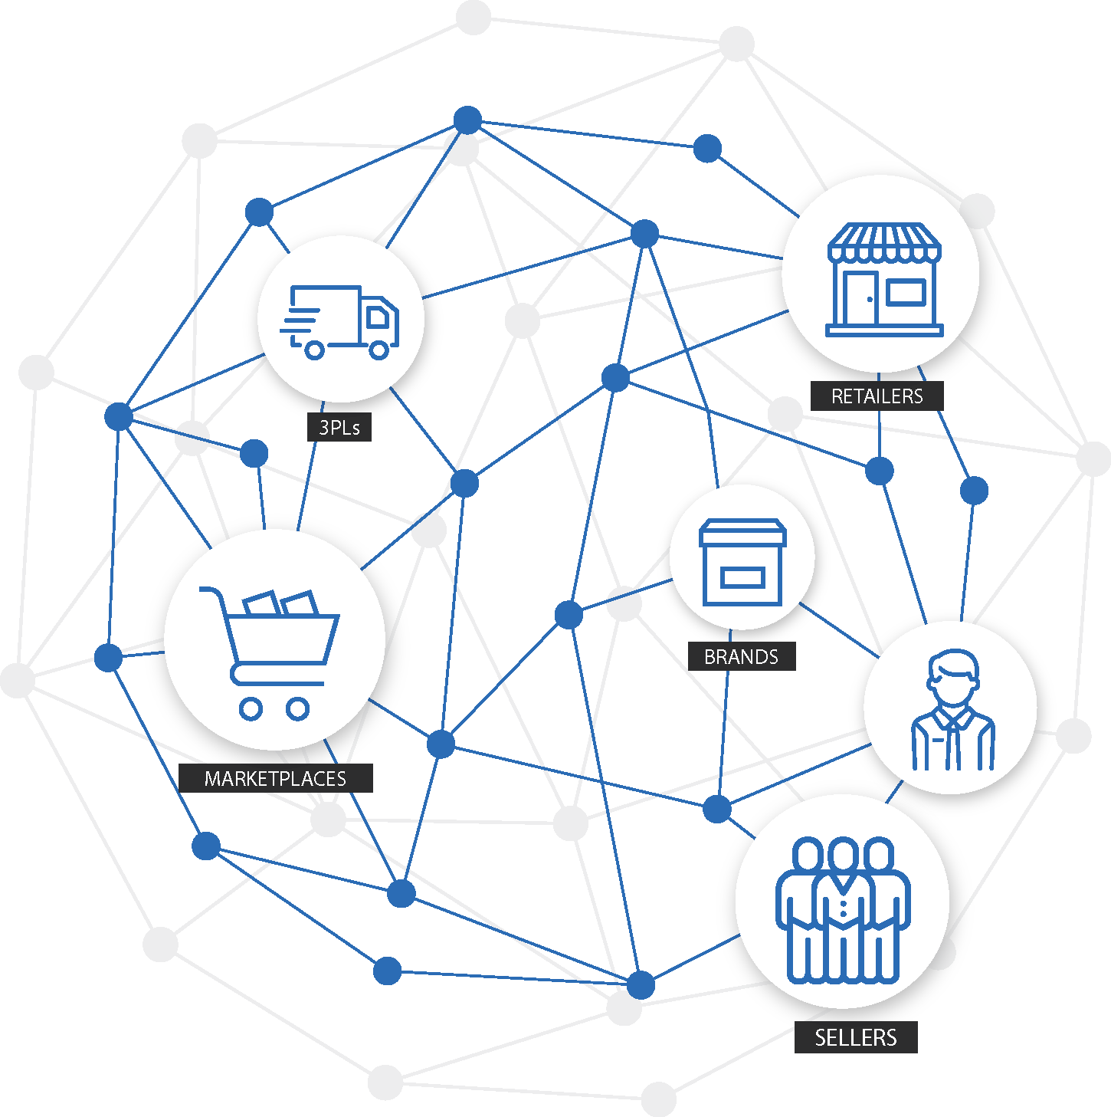
Inventory Reservation

Slide 2
Executive Summary
User can automatically reserve inventory against a channel or a store or B2B customer or Customer group from the available inventory.
This functionality would empower user to block inventory against a party for a priority scenario from centralized inventory.
Reasons for reserving inventory:
Avoiding missing out priority orders due to inventory stock out
Segregating inventory channel wise based on market demand

Slide 3
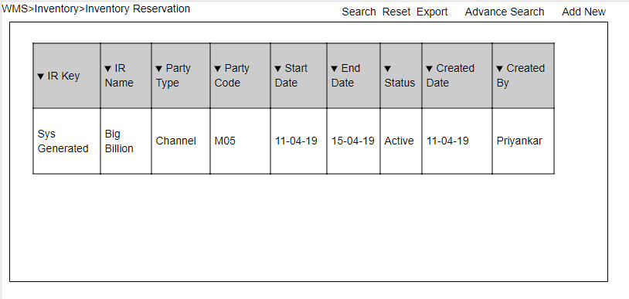
Inventory Reservation enquiry screen

Slide 4
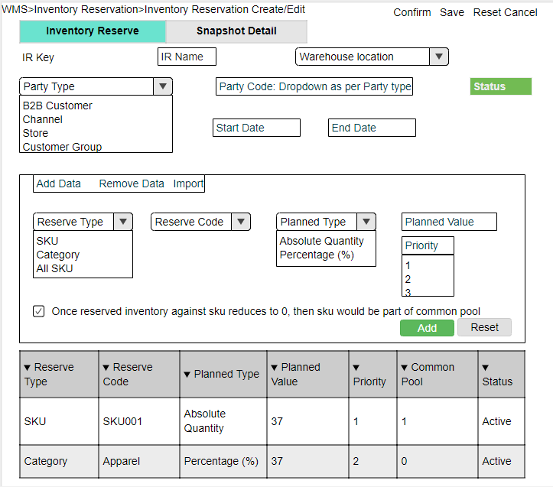
Inventory Reservation create / edit

Slide 5
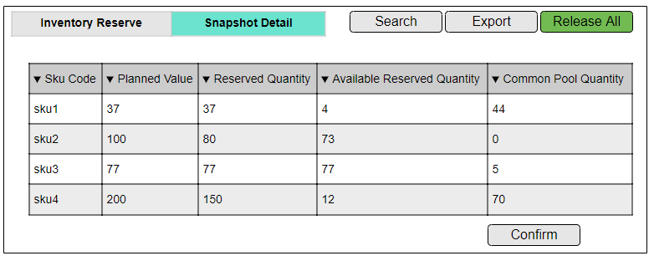
Reserved Inventory Snapshot
This screen shows final reserved quantity with respect to each sku in the IR key only for active skus. So here user can edit the reserved quantity if needed and which should get update in DB. Only ‘Available Reserved Quantity’ column is editable.

Slide 6
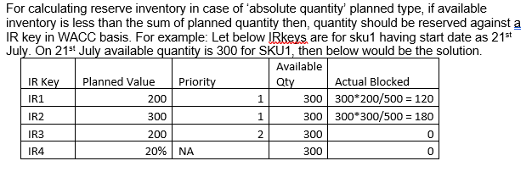
Change in Inventory View screen
A new column ‘Reserved Inventory’ need to be added showing total reserved quantity against a sku
The quantity value should be like a hyperlink, on clicking which would give a pop-out box with reserved inventory against ‘IR Key’
Inventory view export also would be updated with necessary changes like addition of Reserved Inventory column.

Slide 7
User Journey
Happy Flow/ New Inventory Reservation creation:
A user would open Inventory Reservations screen then click on Add new
Inventory Reservation Create/ Edit screen would open
IRKey is a system generated document no against an entry
User feels all the field correctly with start date and end date
Details filling flow Warehouse -> Reservation type -> Sku selected -> Save.
Post filling data user need to click on ‘confirm’ to create the record
As per the start date & End the IRKey would get active or inactive based on blocked inventory and available inventory.

Slide 8
Suggested Change post Discussion
Safety stock level – There would be check box for enabling safety stock. If safety stock is enabled, whenever the reserved inventory would reduce to the safe stock level, then if there is common pool inventory then the reservation would get replenish.
Inventory pushed to customer group would be common poll+ reserved quantity. But actual reserved inventory would get allocate against the order from Customer group and for confirmed portion of order, user need to manually decide how much quantity to fulfil and accordingly need to update the reserved quantity.

Slide 9


